Slide 1

Cosmo Crunch
Products Career Newspaper Our Story
WELCOME!
Welcome to CosmoCrunch — where breakfast blasts off!
Get ready to explore a galaxy of flavor with cereals crafted for cosmic mornings. Whether you're a starry-eyed kid or a full-grown astronaut, our space-inspired bites are here to fuel your next mission. Buckle up—your taste buds are about to go interstellar.

Slide 2
WELCOME!
Welcome to CosmoCrunch — where breakfast blasts off!
Get ready to explore a galaxy of flavor with cereals crafted for cosmic mornings. Whether you're a starry-eyed kid or a full-grown astronaut, our space-inspired bites are here to fuel your next mission. Buckle up—your taste buds are about to go interstellar.
GET TO KNOW US
At CosmoCrunch, we believe breakfast should be an adventure. Born from a love of space and snacks, we're on a mission to make mornings more fun, flavorful, and just a little bit cosmic. Join us as we orbit beyond the ordinary—one crunchy bite at a time.
OUR PRODUCTS
our cereals are crafted to delight space explorers of all ages. Each blend is packed with stellar flavor and a sprinkle of imagination—because breakfast should be anything but boring.

Slide 3
JOIN US!
Whether you’re dreaming of launching a career that’s out of this world or just want to stay in the loop with our latest galactic goodies, we’ve got a spot for you. Help us build the future of breakfast—apply to join the CosmoCrunch crew or simply subscribe for cosmic updates, exclusive offers, and sneak peeks from cereal space.
SUBSCRIBE TO OUR NEWSLETTER!:
name:
email-address:
SEND
By checking this box, you’re giving us permission to beam tasty updates, stellar deals, and other cereal-related transmissions straight to your inbox. No space spam—promise!
YOU HAVE REACHED THE END OF THE EXPEDITION
Return up

Slide 4

Home > Products
main menu
search
Products
Item #1
Item #2
Item #3
Item #1
Item #2
Item #3
Item #2
Item #3
Notes:
Option 1: transition when button up is pressed

Slide 5




x
Home > Products
Cosmo
CRUNCH
Come Taste The Stars
Products
our products
career
newspaper
our story
<
Item #1
Item #2
Item #3
+
DIG DEEPER
BE SOCIAL
Item #1
Item #2
Item #3
Item #2
Item #3
..
..
..
..
Notes:
Option #2: transition when top button is pressed

Slide 6
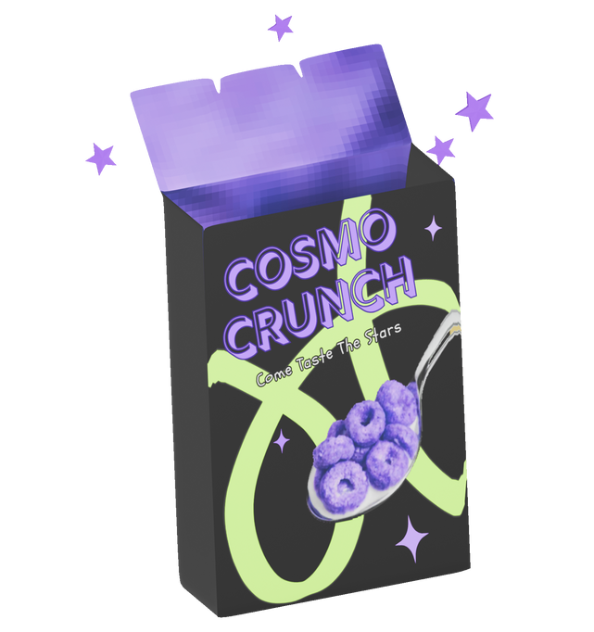
x
Home > Products
MILKY METEORS
ingredients?
Get ready for a crunch that’s out of this world! Milky Meteors™ are cosmic cocoa cereal clusters with creamy vanilla "moon dust" swirls. Every bite is like a meteor shower of flavor—sweet, crunchy, and explosively fun.
Other versions?
Preparation?
VERSIONS:
Notes:
Option #2: transition when top button is pressed

Slide 7
x
Home > Products
INGREDIENTS:
MORE ABOUT THIS PRODUCT:
Whole grain corn, Cane sugar, Cocoa powder, Natural vanilla flavor, Freeze-dried milk swirls, Sea salt, Sunflower oil, Baking soda, Vitamin & mineral blend (including iron, B12, and D3)
+
question #1:
PREPARATION:
question #2:
+
Just pour into your favorite space bowl, add milk (or your preferred galaxy-based alternative), and prepare for liftoff. Also delicious straight out of the bag for an on-the-go snack between missions!
question #3:
+
RELATED PRODUCTS:
<
>
Notes:
Option #2: transition when top button is pressed

Slide 8

ABOUT US:
CONTACT US:
name:
email-address:
message:
SEND

